Slide 1
Unit - 5
Convolution Neural Networks

Slide 2
FULLY CONNECTED LAYER
All possible connections layer-to-layer are present, meaning every input of the input vector influences every output of the output vector.

Slide 3
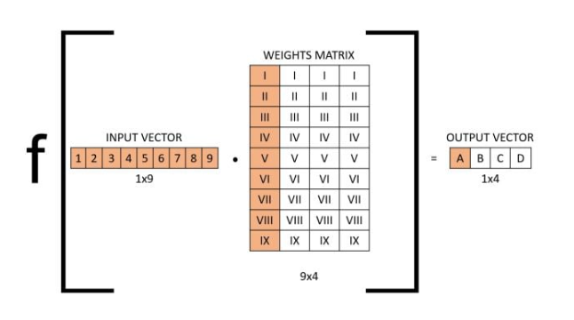
If we take a layer in a fully connected neural network with an input size of nine and an output size of four, the operation can be visualized as follows:

Slide 4
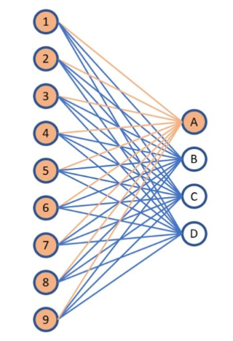
You can also visualize this layer the following way:

Slide 5
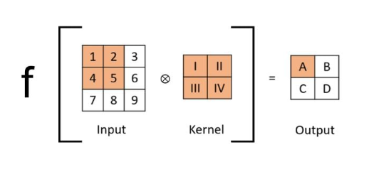
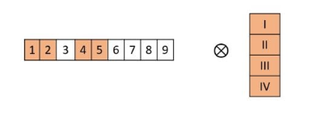
Convolutional Layer

Slide 6
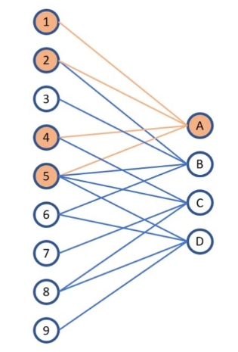

Slide 7
Convolution Operations
The network employs a mathematical operation called Convolution.
Convolution is a specialized kind of linear operation.
Convnets (Convolution Neural Networks) are simply neural networks that use convolution in place of general matrix multiplication in at least one of their layers.

Slide 8
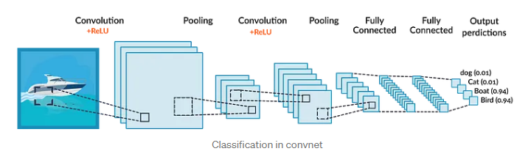
Convolution Operations

Slide 9
Convolution Kernels -A kernel is a small 2D(or 3D) matrix whose contents are based upon the operations to be performed.

Slide 10
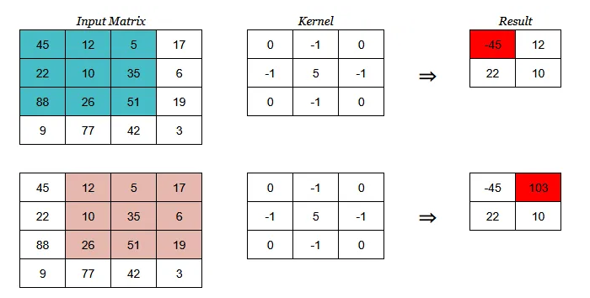
let’s see how a kernel operates on sample matrix:

Slide 11
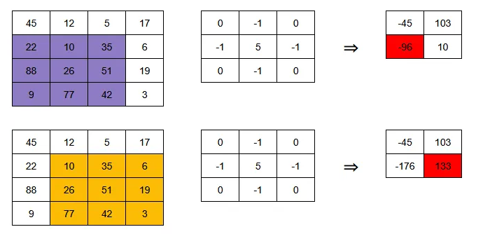

Slide 12
Padding, Stride & Pooling:
https://towardsdatascience.com/applied-deep-learning-part-4-convolutional-neural-networks-584bc134c1e2
https://www.geeksforgeeks.org/cnn-introduction-to-padding/

Slide 13
Performing a convolution operation on three dimensional data :
https://towardsdatascience.com/understanding-1d-and-3d-convolution-neural-network-keras-9d8f76e29610
NOTE: Refer theory part

Slide 14
LeNet and AlexNet
Refer any site

Slide 15
Thank You

